Slide 1
Weekly report: Machine Bed & Yaw System
Week No - 12
Date: 16.12.2025
Supervisor: Prof. Peter Quell
Shoukat Abbas, Luksh Chawla, Sathishkumar Venkatachalam, Shrihari G Kadam
Presented by – Luksh Chawla

Slide 2
Contents
Yaw Brake Design Modifications
Yaw System Finalization
Machine Bed Design Changes
Rear Machine Bed Concept
Assembly Update
References
Luksh Chawla

Slide 3
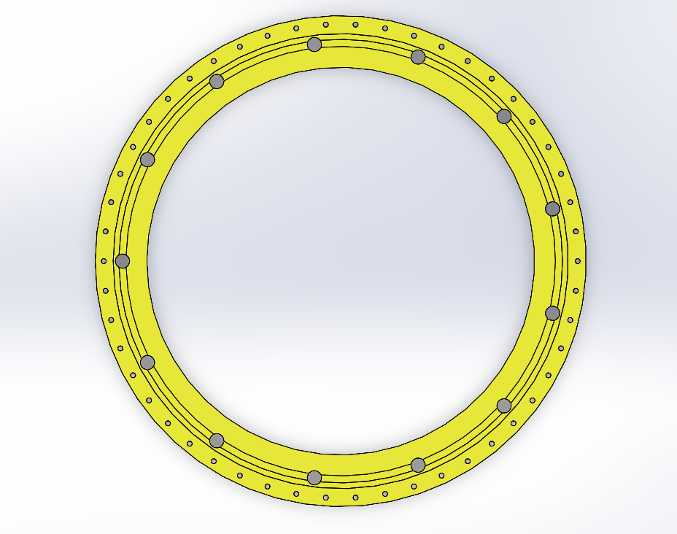
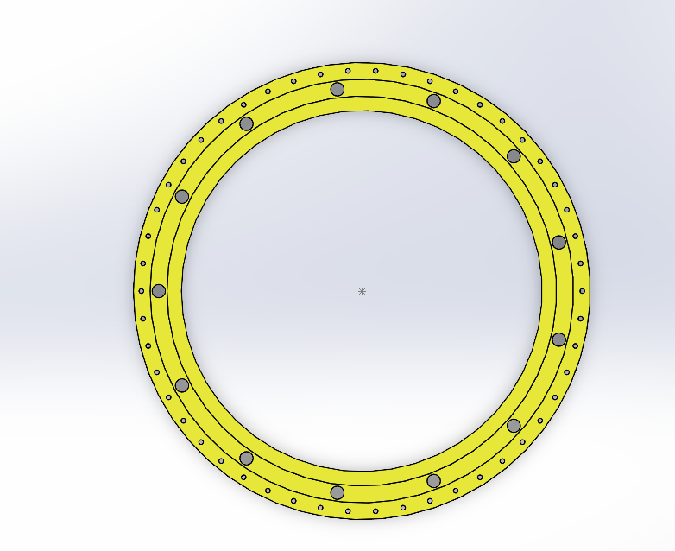
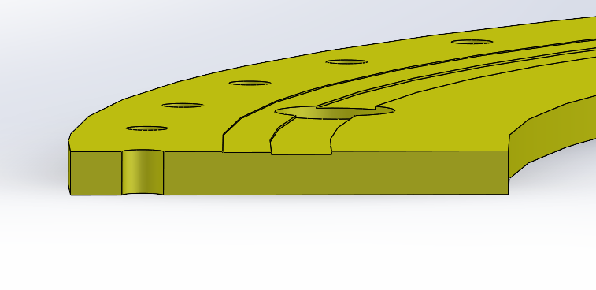
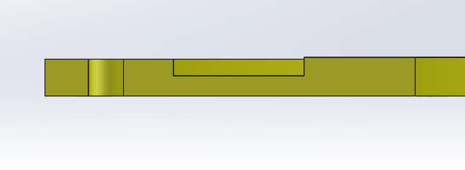
Yaw Brake – Modification Diff.
Yaw brake disk
Old Model
Modified New Brake
Luksh Chawla

Slide 4
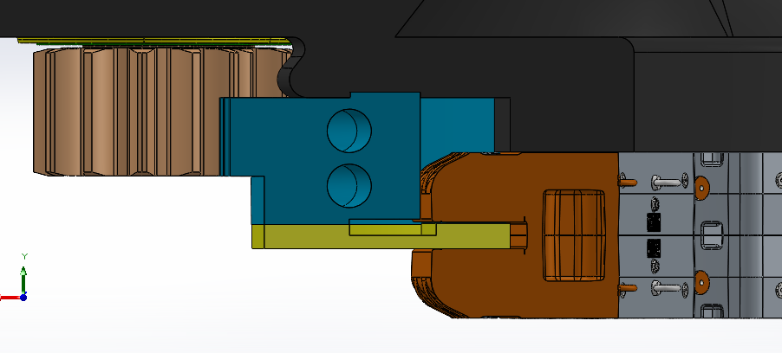
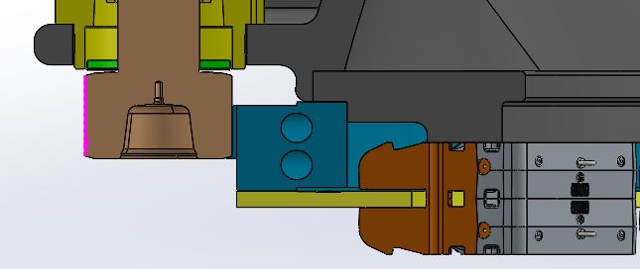
Yaw system Finalization
Yaw brake disk - 3D
Modified Design
Luksh Chawla

Slide 5
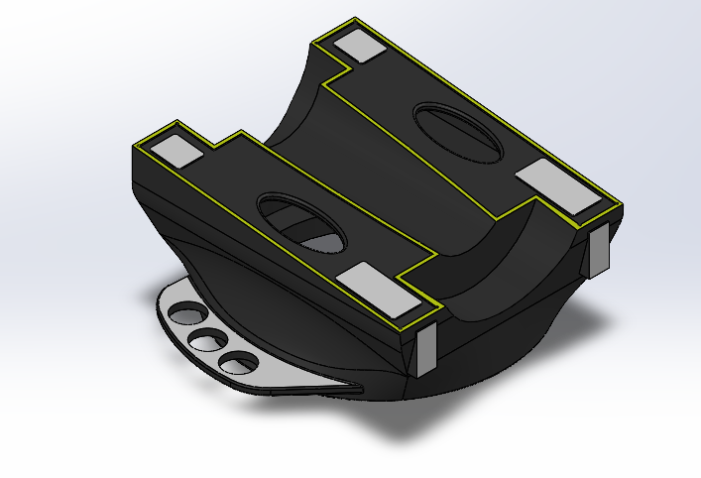
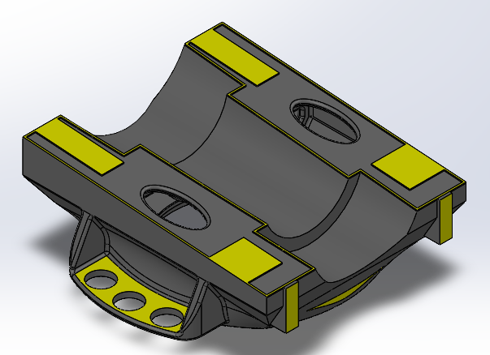
Machine Bed – Modification Diff.
Machine Bed - 3D
Shaft Path Dim Changed
LxBxH Modified
Connection Dim.
Changed
Connection Dim.
Changed
Drive Flange Ribs Added
Machined for Nacelle Support
Luksh Chawla

Slide 6
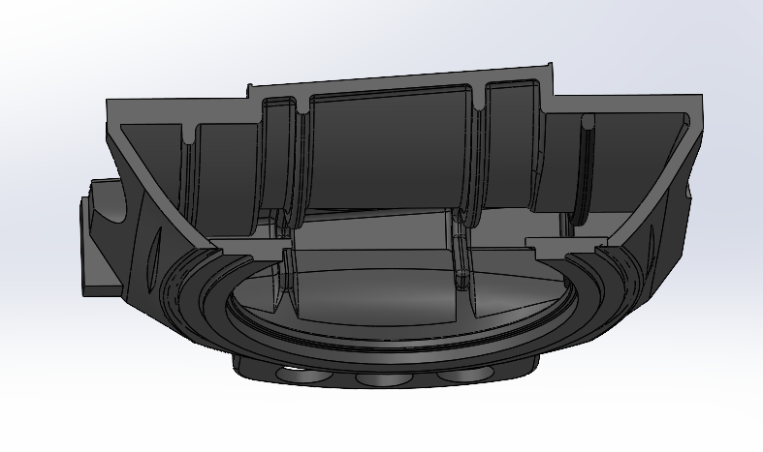
Machine Bed – Section view
Ribs Added for internal Body Support
Luksh Chawla

Slide 7
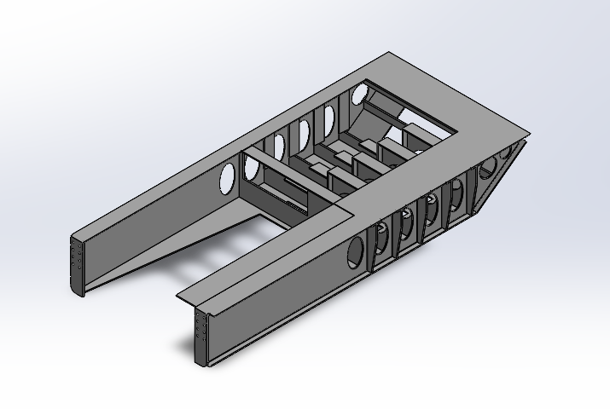
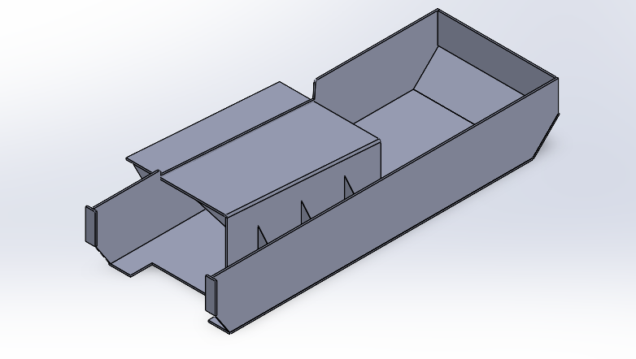
Rear Machine Bed – Concept
* Optimus model- Concept Design
* Optimus Syria - Initial Design
Luksh Chawla

Slide 8
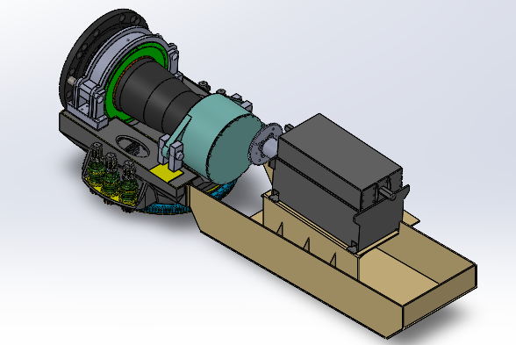
Updated Machine Bed & Yaw System Ass.
Luksh Chawla

Slide 9
References
    Optimus 92 LE (Previous Concept) __ Report_Optimus92LE_Machinebed_Yawsystem.lnk Accesed ( 12/11/2025)
Luksh Chawla

